Slide 1
Presentation on
DETECTION AND Automatic gain control(AGC)

Slide 2
Submitted To: Md:Imran Hossain Associate Professor Dept. Of ICT Comilla University Submitted By: Kohinoor Akter ID No:11809033 Dept. Of ICT Comilla University

Slide 3
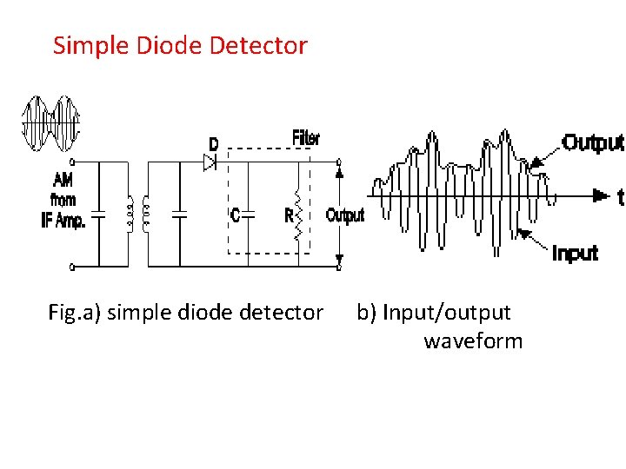
Diode Detector Circuit

Slide 4
Working Process 1.In diode detector circuit ,the diode d is acting like half wave rectifier which will pass only the position half of input AM waveform. 2.The capacitor C charge to the peak voltage of arrived carrier pulse. 3.As soon as capacitor charges to the peak voltage ,it will discharge through Resister R. 4.This process will continue for the next arrival pulse. 5.With the help of filter circuit(R-C) the smooth information signal will be generated at the output of detector circuit.

Slide 5
Need Of AGC 1.The receiver by the receiver where is continuosly.Some signal are receive with stronger strength and signal are receive with weaker strength. 2.If the receiver gain is made constant that the receiver output will flactual and it not desireable. 3.Therefore there is a need of AGC in order to maintain standard receiver output.

Slide 6
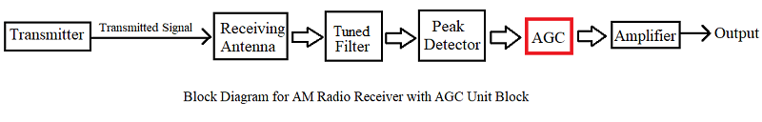
A block diagram of AM radio Receiver with AGC

Slide 7
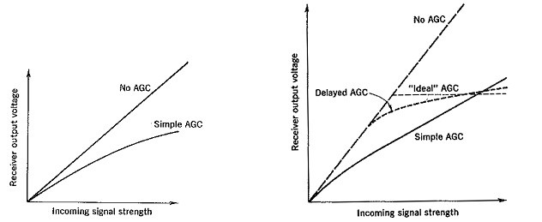
AGC Curve

Slide 8
Simple AGC 1.In simple AGC circuit the overall gain of the receiver is automatically adjusted by seeing the detector output. 2.In this circuit the gain of weak incoming signal is also reduced along with stronger incoming signal.

Slide 9
Advantages 1.Low Cost 2.Simplicity Disadvantage 1.The gain of weak incoming signal reduced also. Application It used in domestic radio receiver.

Slide 10
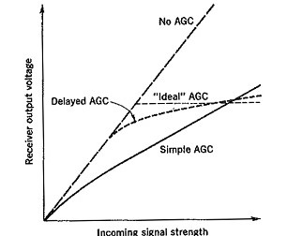
Delayed AGC
Fig: various characteristics of AGC

Slide 11
Delayed AGC(contd.) 1.In delayed AGC the gain of receiver will not adjusted until the adequate level of weak incoming signal is reached. 2.After that the gain of receiver is reduced in order to obtain constant receiver output.

Slide 12
Advantages of Delayed AGC 1.Gain of receiver is not reduced for weak signal strength. 2.Gain of receiver is reduced for stronger incoming signal only. 3.The characteristics of delayed AGC is similar to the ideal curve. Disadvantage of Delayed AGC 1.Circuit is complex.

Slide 13
Application of Delayed AGC 1.It is used in high communication receiver.

Slide 14
THANK YOU

